Slide 1
Point allocation for spring 2014
It’s easy…

Slide 2
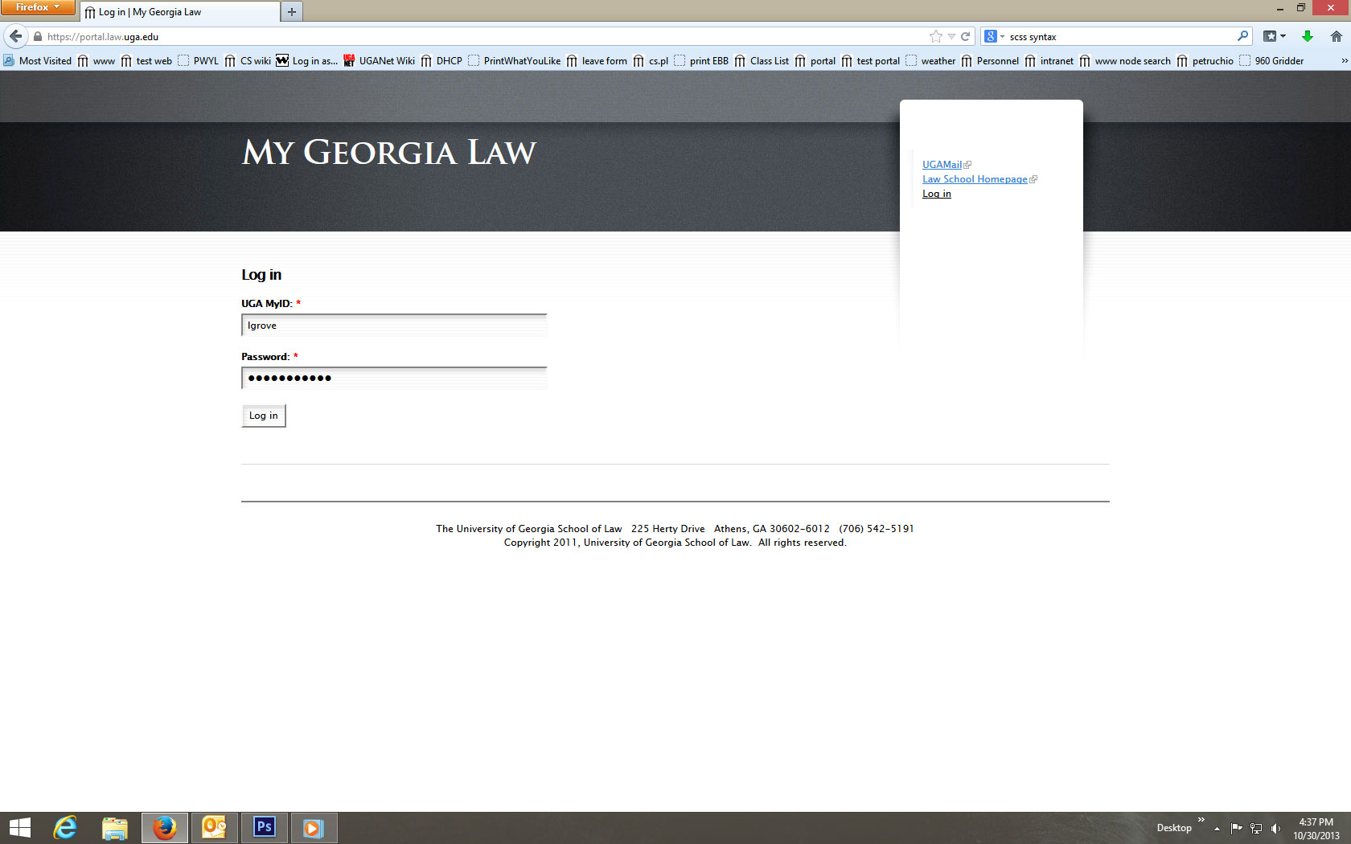
Log in to My Georgia Law

Slide 3
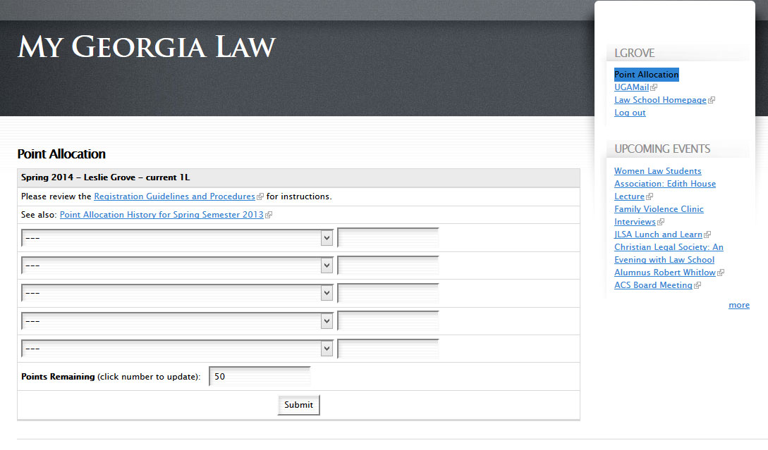
Click the Point Allocation link

Slide 4
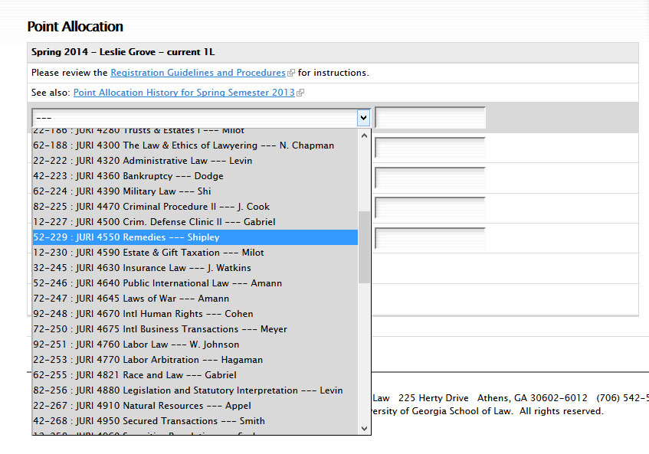
Select up to 5 courses

Slide 5
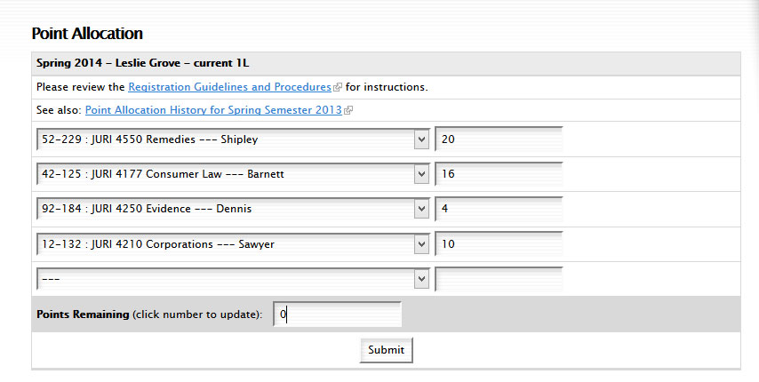
Assign points (total of 50 or 65)

Slide 6
You’re done! Print this page.

Slide 7
Come back later to view results

